Slide 1
Introduction to Sahaja Yoga
Grade 1, Nirmala Vishwa Vidya Peetham (Home School), Dunwoody GA (Dekalb County)
Notes:
Hi! My name is Virata! In this presentation I am going to give a short introduction to Sahaja yoga. I will explain about Sahaja Yoga, Kundalini energy, and about Self-Realization.

Slide 2

What is Sahaja Yoga?
We are surrounded by energy, we can call this energy as God or Mother Nature or Universal energy. But we don’t know how to get connected to this energy or feel its presence.
Sahaja Yoga makes us physically feel its presence by a process called self-realization.
Shri Mataji Nirmala Devi is the founder of “Sahaja Yoga” meditation, who has given this gift to awaken our inner energy and connect it to the universal energy around us.
It is very simple and anybody can feel this experience.
By practicing “Sahaja Yoga” meditation, we can always be happy and peaceful.

Slide 3
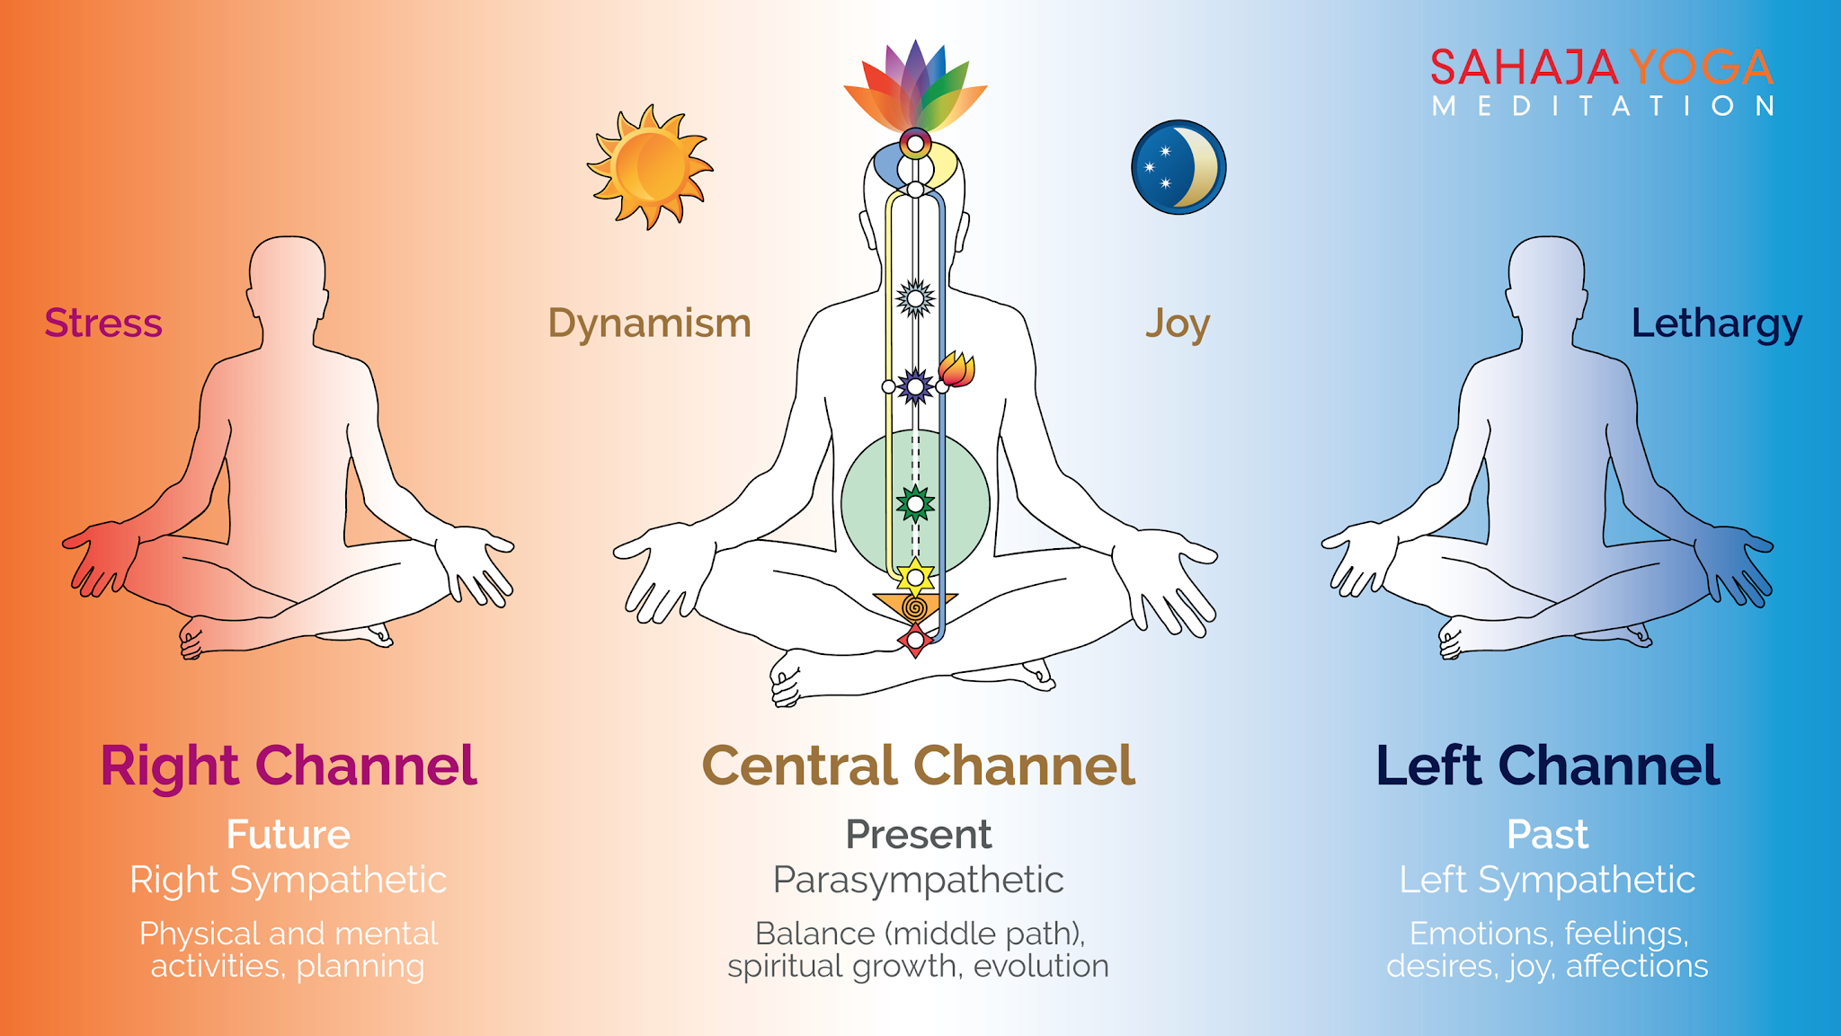
Chakras, Channels & Self-Realization
Chakras: Chakras are like energy centers which control different parts within us. Sahaja Yoga guides on how to take care of our seven chakras: Mooladhara, Swadhisthana, Nabhi (Void), Anahata, Vishuddhi, Agnya, and Sahastrara. When our chakras are in balance, we will be healthy.
Channels: There are 3 Channels within us which control our past, present and future activities.
Kundalini energy: Kundalini energy is motherly energy inside us. It’s in the bottom of the spinal cord in a triangular bone.
Self-Realization: When our Kundalini energy rises and passes through all the chakras and reaches the chakra on top of our head, and gets connected with the divine energy around us, this is called Self-Realization. We can feel this in our hands as cool breeze.

Slide 4
Benefits
When we practice Sahaja Yoga meditation everyday morning and evening (around 5 to 10 minutes), and meditate in a group (called as collective meditation) at least once a week, it helps us in many ways:
It cures all physical, mental, and emotional problems
It makes us peaceful, and always keeps us in balance
It gives us good health, and happiness
It teaches us to help each other, and enjoy as a group
It will make us free from stress, and tensions

Slide 5
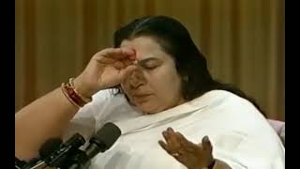
Experience Self-Realization by Shri Mataji

Slide 6
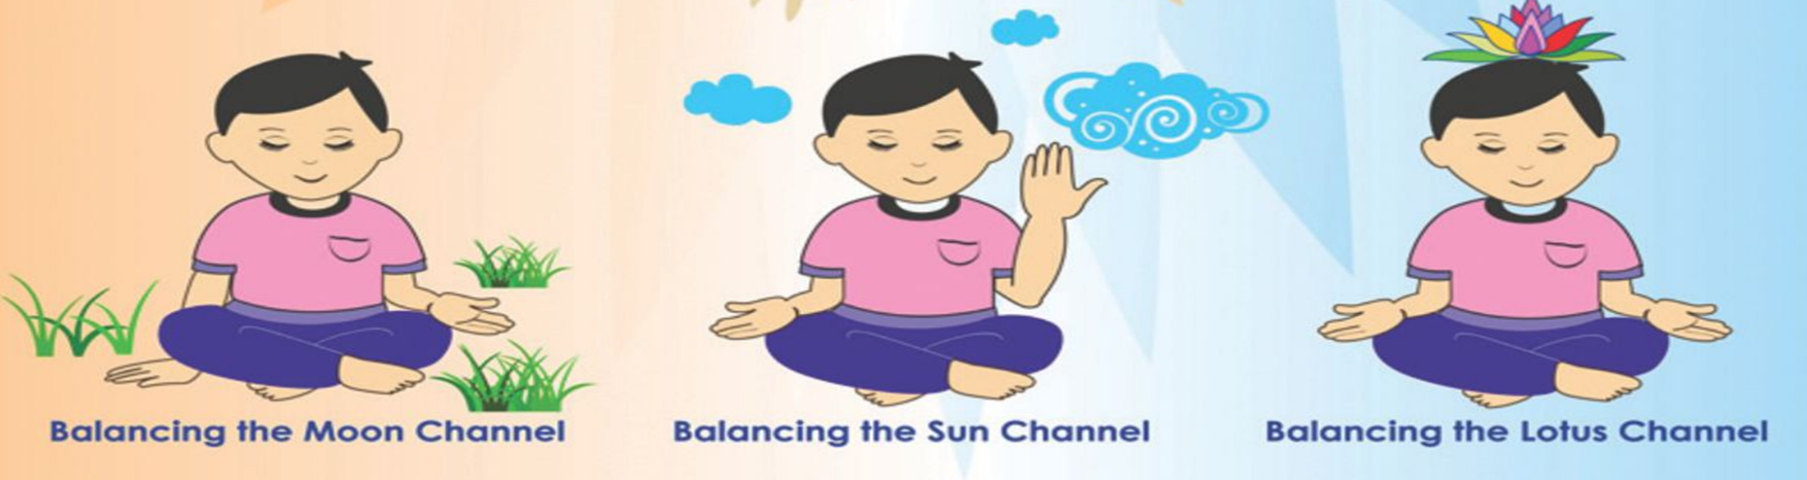
Daily meditation
You need to clean all 3 channels: left, right and central channels daily to remove imbalances, and sit in balance for a few minutes to feel the cool breeze and peacefulness. This is called Meditation.
Mother Kundalini, please balance my Left channel
Mother Kundalini, please balance my Right channel
Mother Kundalini, please keep me in the present (balancing the Central channel)

Slide 7
Collective meditation & References
Collective meditation is important because we can feel more calmness, improve our meditation and learn so many techniques to keep us always in balance
To attend collective meditation in Atlanta, GA, please visit 1122 Cambridge Square (basement) or search other centers near you (example: Sahaja Yoga International School, Canajoharie is in New York when we search it in Google Maps).
For more information, visit:
sahajayoga.org
freemeditation.com
Meditation-at-Home-Booklet - you can visit other other websites for more information.

